Slide 1
Brazil Housing
Mentor Name Shruti Gode
Learner Name Manju Thomas

Slide 2
Business Objective
“work from home”, which describes a modern working arrangement where employees perform job responsibilities remotely.
People will choose the city is more affordable. Castro brazil Inc. is a real estate management firm in Brazil.
Help the firm to find out suitable cities for bachelors, mid-sized family and Large family.

Slide 3
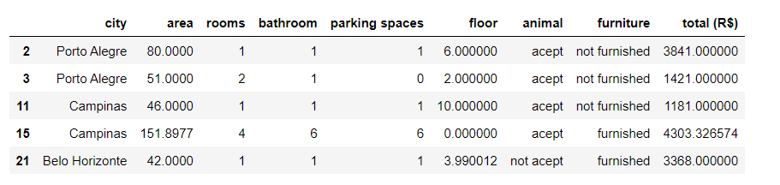
LEVEL 0 Analysis Understand the data
Excluded expensive cities Rio de jenero and São Paulo.
The column 'total' in the dataset is the sum of hoa, rent amount, property tax and fire insurance columns. So considering only total column for analysis.

Slide 4
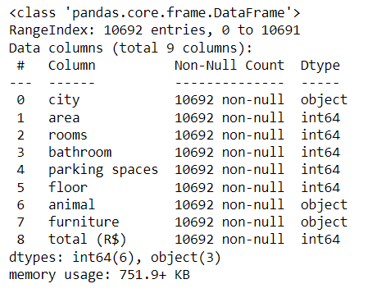

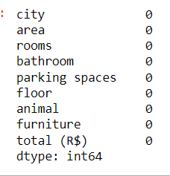

Slide 5
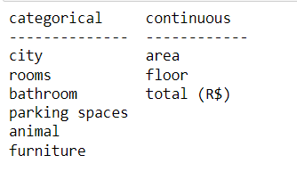
LEVEL 1 Analysis
Separating categorical and numerical columns
Measure the central tendency (mean, median, mode)
Treating missing value with mean or mode.
Measure the dispersion values
Check for outliers and do the outliers treatment
checking the unique values in columns
visualizing the data with count plot , Tree map,Box plot or Histogram

Slide 6
Univariate analysis of categorical and numerical variables.
city: 38% houses are at Belo Horizonte and 36% at Porto Alegre.
rooms: Houses are available with 10 room, But the majority are four-room houses.
bathroom: Houses are available with 10 bathrooms, But the majority are three-bathroom houses.
parking spaces: Space available for 0 to 8,but 0 to 2 is more.
animal: Pets are accepted in 75% of houses 25% are not accepted.
furniture: 75% houses are not furnished and 25% are furnished.
area: After outlier treatment area of houses are 200-3000sqft.
floor: After outlier treatment floors are 0-13.
total: After outliers treatment the price range is 500-8000.

Slide 7
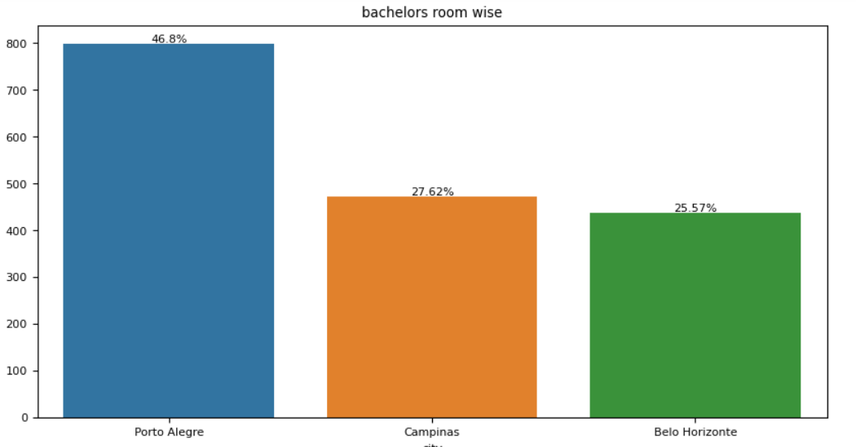
Univariate analysis of room for bachelors to relocate
Interpretation:
As per the above count plot, Porto Alegre city has 47% with <=2 rooms .

Slide 8
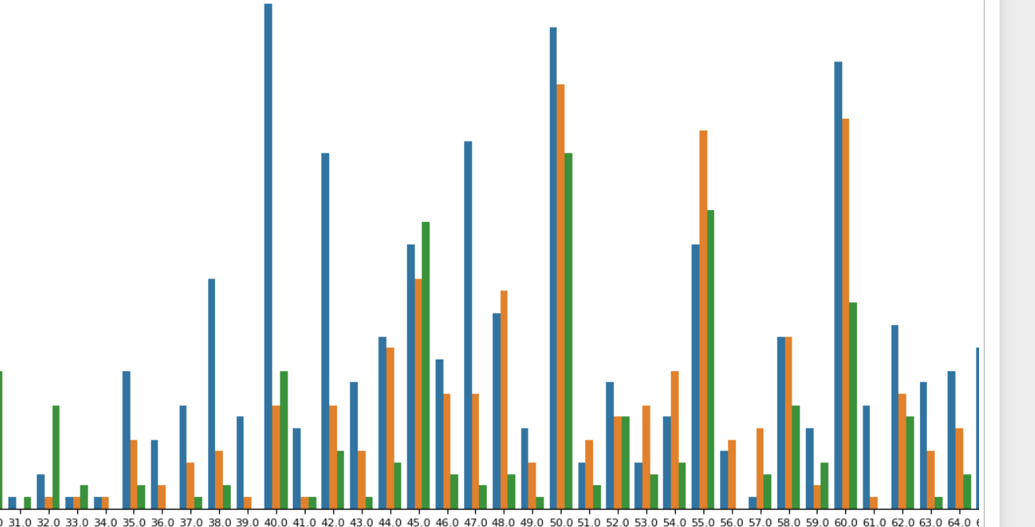
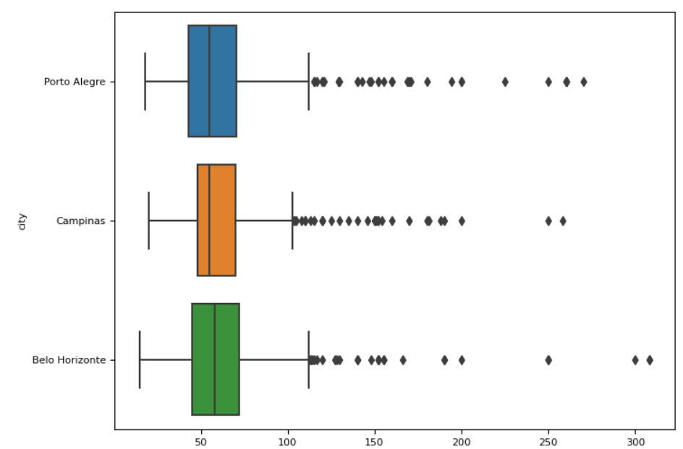
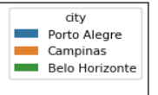
Bivariate Analysis Relationship of Area with city
Interpretation:
For the bachelors, Porto alegre is the city have widest range of rooms available than Belo Horizonte and Campinas city with area 20-120.

Slide 9
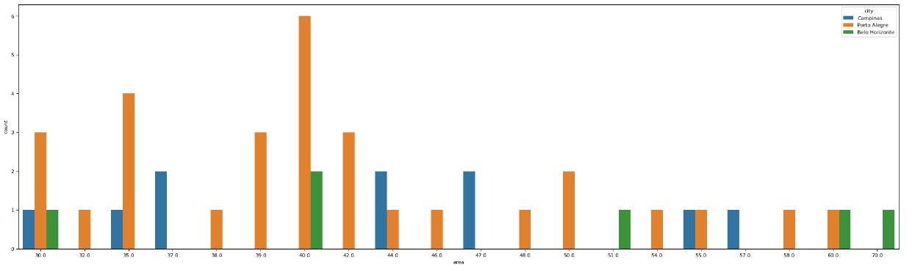
Multivariate Analysis To find which city have most affordable place for bachelors to relocate. We consider the area lay between the 30 -100, and other facilities like bathroom(<=2) and furniture(furnished)
Interpretation:
Porto Alegre has widest range of houses with area between 30 to 100 , with <=2 rooms , bathrooms and furniture with low cost. As per the above count plot Porto Alegre is the most affordable city for bachelors.

Slide 10
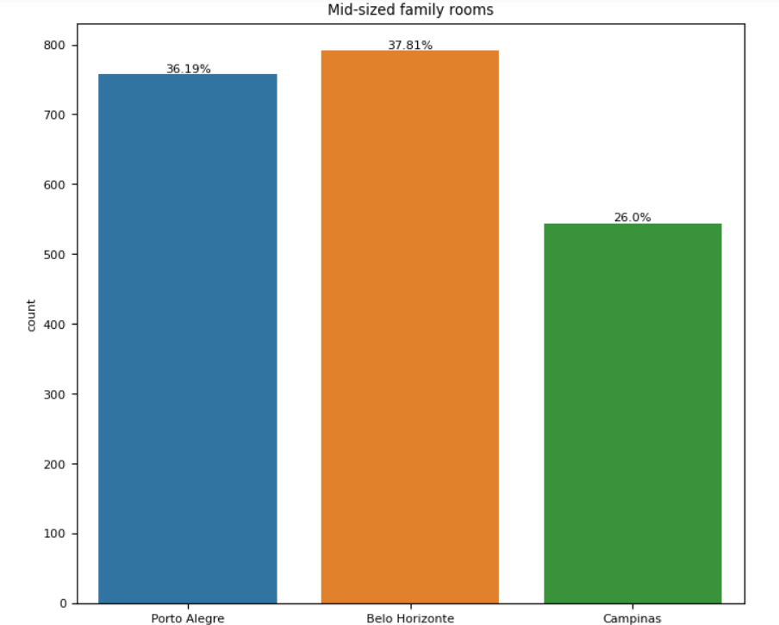
Univariate analysis of room for Mid-sized Families to relocate
Interpretation:
For mid-sized families, Belo Horizonte city and Porto Alegre have widest range of rooms available with 38% and 36% with 2 or 3 rooms.

Slide 11
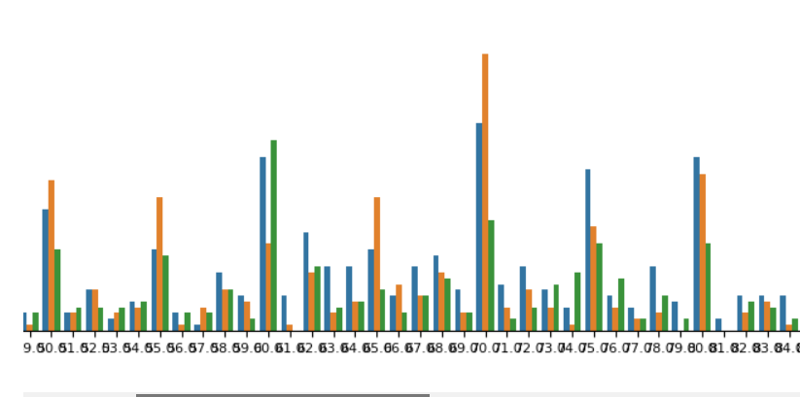
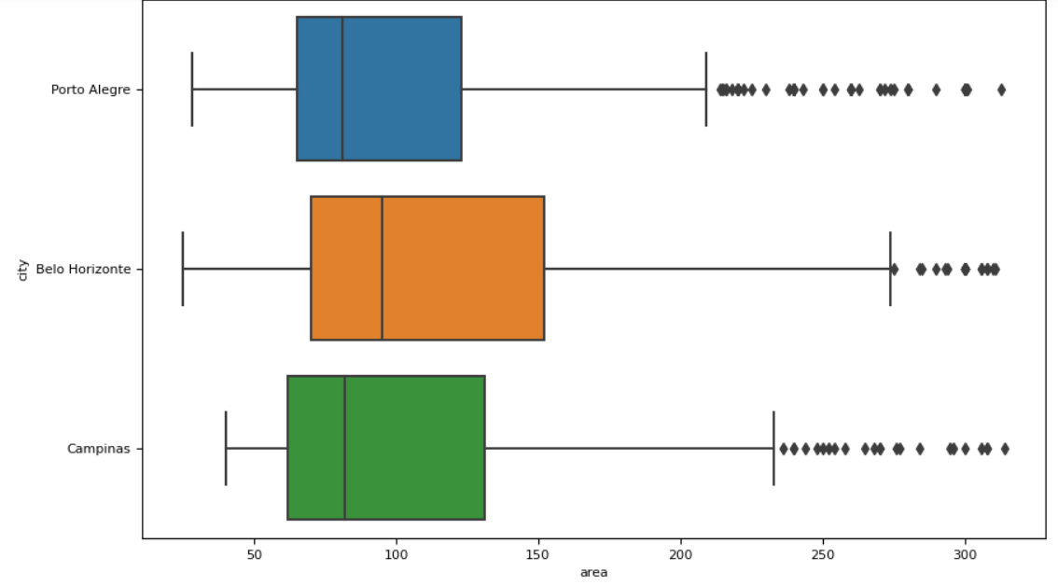

Bivariate analysis. Relationship of Area with city
Interpretation:
In the mid sized families, Belo Horizonte and Porto Alegre are the cities have the widest range of houses with area 20-250 compare to other cities.

Slide 12
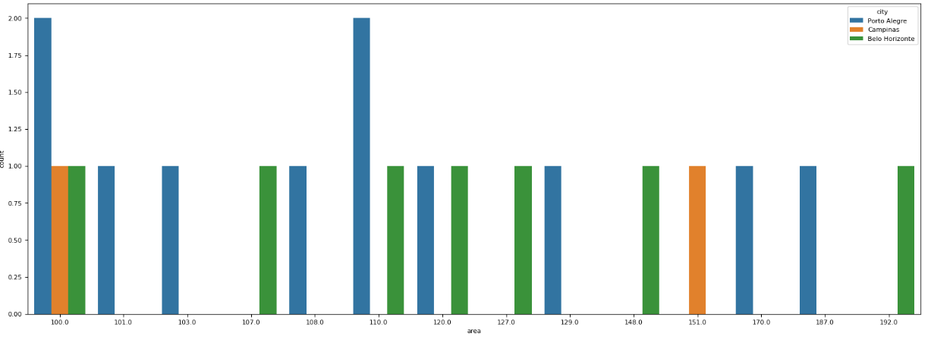
Multivariate Analysis
To find which city have most affordable place and more facilities like area between 100-200 ,more number of bathroom, pet allowed, furnished.
Interpretation:
Belo Horizonte and Porto Alegre have widest range of houses with area between 100-200,
with <=4 rooms and with more facilities in low rent.
As per the analysis Belo Horizonte and Porto Alegre are the most affordable city for mid-sized family.

Slide 13
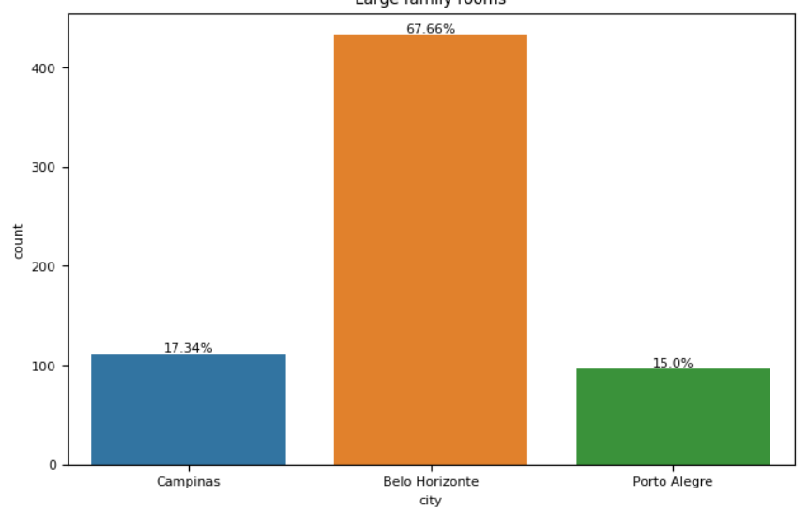
Univariate Analysis for Large Family to relocate.
Interpretation:
For Large families, Belo Horizonte city has the widest range of rooms available with 68% with >=4 rooms.

Slide 14
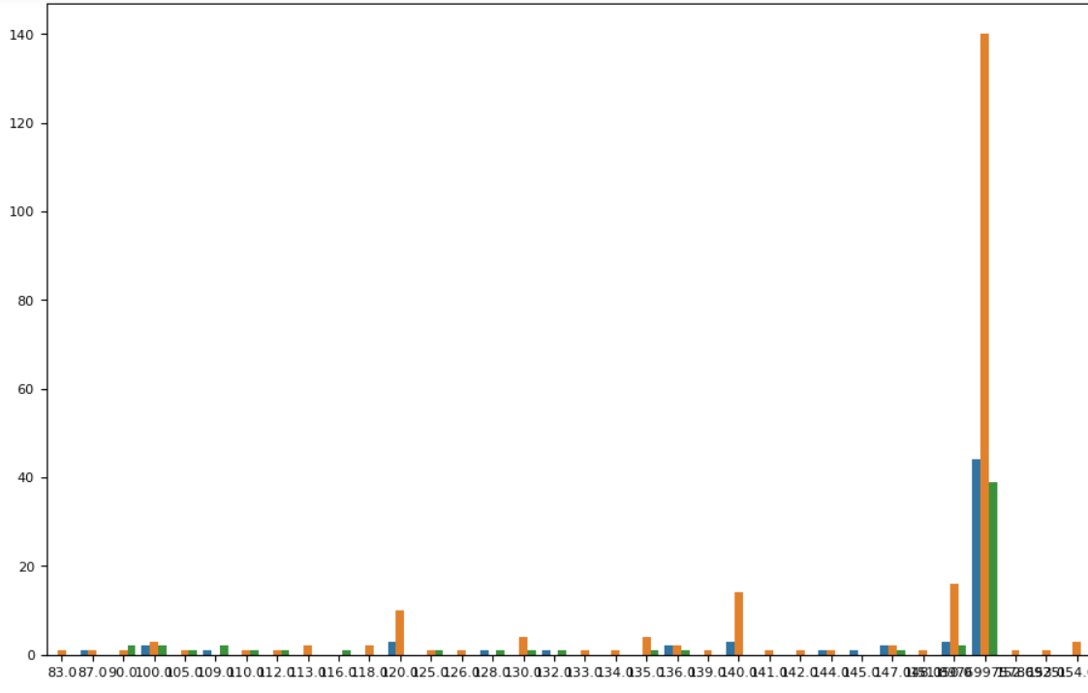
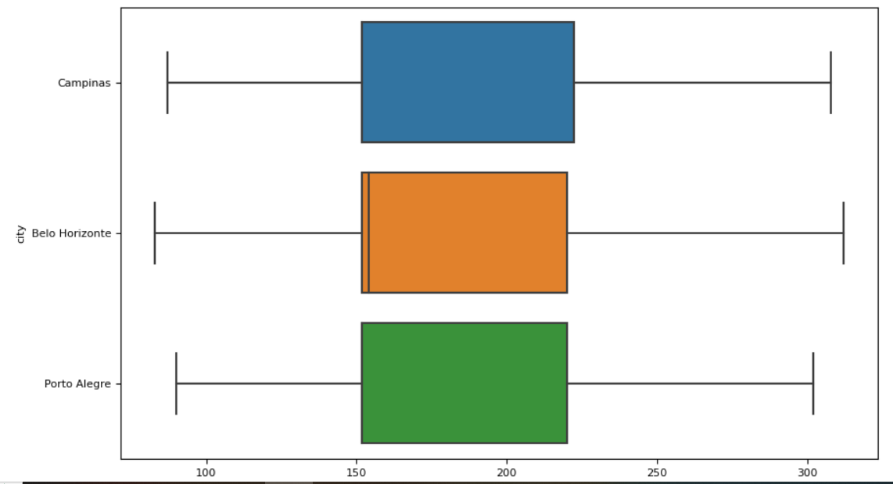
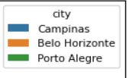
Bivariate analysis Relationship of Area with city
Interpretation:
For large families, Belo Horizonte city has the widest range of houses with area between 70-320 compare to other cities .

Slide 15
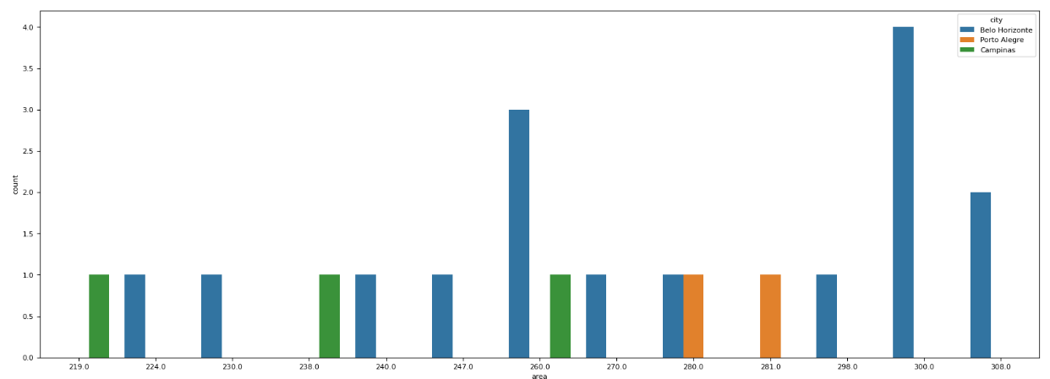
Multivariate Analysis Deeper Analysis To find which city have most affordable place and more facilities like area >200 ,more number of bathrooms, pets allowed, parking space of more vehicles and furnished.
Interpretation:
Belo Horizonte has widest range of houses with area >200, with >4 rooms, more number of bathrooms, pets allowed, parking space of more vehicles and furnished.
As per the analysis Belo Horizonte is the most affordable city for Large family.

Slide 16
CONCLUSION Castro brazil can consider
‘Porto Alegre’ for best city for ‘bachelors’ to put up.
‘Belo Horizonte city’ and ‘Porto Alegre’ for ‘mid-sized’ family.
‘Belo Horizonte city’ for ‘Large family’.

Slide 17
THANK YOU

